Slide 1
UESTC1008: Microelectronic Systems
Numbers
Guodong Zhao

Slide 2
Binary Numeral System
Used in computers as a series of "off" and "on" switches
A way to write numbers using only two digits (‘bits’): 0 and 1
Each digit's place value is twice as much as that of the next digit to the right and the place value increases by a power of two (1's, 2's, 4's place, etc.)
In decimal, each digit holds ten values, and the place value increases by a power of ten (1's, 10's, 100's place, etc.)
http://simple.wikipedia.org/wiki/Binary_numeral_system
Decimal | Binary | Explanation
1 | 0001 | 0+0+0+1
2 | 0010 | 0+0+2+0
3 | 0011 | 0+0+2+1
4 | 0100 | 0+4+0+0
5 | 0101 | 0+4+0+1
6 | 0110 | 0+4+2+0
7 | 0111 | 0+4+2+1
8 | 1000 | 8+0+0+0
9 | 1001 | 8+0+0+1
10 | 1010 | 8+0+2+0
11 | 1011 | 8+0+2+1
12 | 1100 | 8+4+0+0
13 | 1101 | 8+4+0+1
14 | 1110 | 8+4+2+0
15 | 1111 | 8+4+2+1
16 | 10000 | 16+0+0+0+0

Slide 3
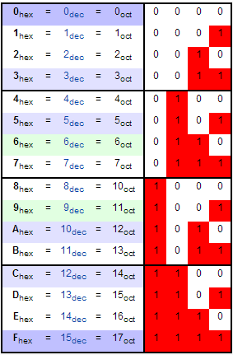
Hexadecimal System
In mathematics and computing, hexadecimal (also base16, or hex) is a positional numeral system with a radix, or base, of 16.
It uses sixteen distinct symbols, most often the symbols 0–9 to represent values zero to nine, and A, B, C, D, E, F (or alternatively a–f) to represent values ten to fifteen.
For example, the hexadecimal number 2AF3 is equal, in decimal, to(2 × 16³) + (10 × 16²) + (15 × 16¹) + (3 × 16⁰), or 10995.

Slide 4
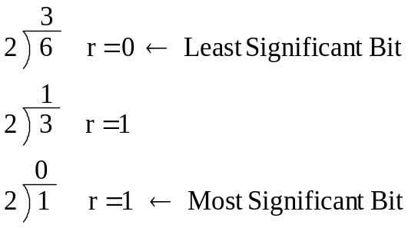
Decimal ‒to‒ Binary Conversion
The Process : Successive Division
  Divide the Decimal Number by 2; the remainder is the LSB of Binary Number.
  If the quotation is zero, the conversion is complete; else repeat step (a) using the quotation as the Decimal Number. The new remainder is the next most significant bit of the Binary Number.
Example:
  Convert the decimal number 6₁₀ into its binary equivalent.
∴ 6₁₀ = 110₂
Notes:
Binary Number System
Digital Electronics™
2.1 Introduction to AOI Logic
Project Lead The Way, Inc.
Copyright 2009

Slide 5
Dec → Binary : Example #1
Example:
  Convert the decimal number 26₁₀ into its binary equivalent.
Notes:
Binary Number System
Digital Electronics™
2.1 Introduction to AOI Logic
Project Lead The Way, Inc.
Copyright 2009

Slide 6
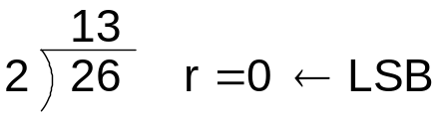
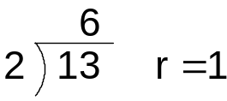
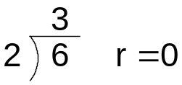
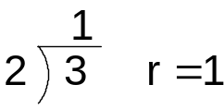
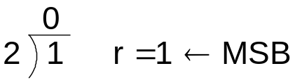
Dec → Binary : Example #1
Example:
  Convert the decimal number 26₁₀ into its binary equivalent.
Solution:
∴ 26₁₀ = 11010₂
Notes:
Binary Number System
Digital Electronics™
2.1 Introduction to AOI Logic
Project Lead The Way, Inc.
Copyright 2009

Slide 7
Dec → Binary : Example #2
Example:
  Convert the decimal number 41₁₀ into its binary equivalent.
Solution:
Notes:
Binary Number System
Digital Electronics™
2.1 Introduction to AOI Logic
Project Lead The Way, Inc.
Copyright 2009

Slide 8
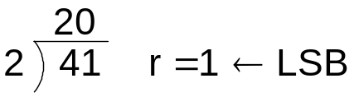
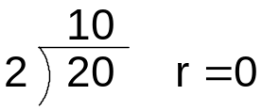
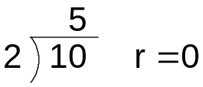
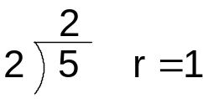
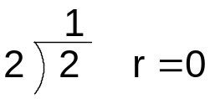
Dec → Binary : Example #2
Example:
  Convert the decimal number 41₁₀ into its binary equivalent.
Solution:
∴ 41₁₀ = 101001₂
Notes:
Binary Number System
Digital Electronics™
2.1 Introduction to AOI Logic
Project Lead The Way, Inc.
Copyright 2009

Slide 9
Binary ‒to‒ Decimal Process
The Process : Weighted Multiplication
  Multiply each bit of the Binary Number by it corresponding bit-weighting factor (i.e. Bit-0→2⁰=1; Bit-1→2¹=2; Bit-2→2²=4; etc).
  Sum up all the products in step (a) to get the Decimal Number.
Example:
  Convert the binary number 0110₂ into its decimal equivalent.
0 |  | 1 |  | 1 |  | 0
2³ |  | 2² |  | 2¹ |  | 2⁰
8 |  | 4 |  | 2 |  | 1
0 | + | 4 | + | 2 | + | 0 | = | 6₁₀
Bit-Weighting
Factors
∴ 0110 ₂ = 6 ₁₀
Notes:
Binary Number System
Digital Electronics™
2.1 Introduction to AOI Logic
Project Lead The Way, Inc.
Copyright 2009

Slide 10
Binary → Dec : Example #1
Example:
  Convert the binary number 10010₂ into its decimal equivalent.
Solution:
1 |  | 0 |  | 0 |  | 1 |  | 0
2⁴ |  | 2³ |  | 2² |  | 2¹ |  | 2⁰
16 |  | 8 |  | 4 |  | 2 |  | 1
16 | + | 0 | + | 0 | + | 2 | + | 0 | = | 18₁₀
10010₂ = 18₁₀
Notes:
Binary Number System
Digital Electronics™
2.1 Introduction to AOI Logic
Project Lead The Way, Inc.
Copyright 2009

Slide 11
Binary → Dec : Example #2
Example:
  Convert the binary number 0110101₂ into its decimal equivalent.
Solution:
Notes:
Binary Number System
Digital Electronics™
2.1 Introduction to AOI Logic
Project Lead The Way, Inc.
Copyright 2009

Slide 12
Binary → Dec : Example #2
Example:
  Convert the binary number 0110101₂ into its decimal equivalent.
Solution:
0 |  | 1 |  | 1 |  | 0 |  | 1 |  | 0 |  | 1
2⁶ |  | 2⁵ |  | 2⁴ |  | 2³ |  | 2² |  | 2¹ |  | 2⁰
64 |  | 32 |  | 16 |  | 8 |  | 4 |  | 2 |  | 1
0 | + | 32 | + | 16 | + | 0 | + | 4 | + | 0 | + | 1 | = | 53₁₀
0110101₂ = 53₁₀
Notes:
Binary Number System
Digital Electronics™
2.1 Introduction to AOI Logic
Project Lead The Way, Inc.
Copyright 2009

Slide 13
Negative Binary Numbers
  Four different systems for representing negative numbers have been used in digital computers at one time or another.
    The first one is called signed magnitude. The leftmost bit is the sign bit (0 is + and 1 is -) and the remaining bits hold the absolute magnitude of the number.
    The second system, called one’s complement, also has a sign bit with 0 for a plus and 1 for minus. To negate a number, replace each 1 by 0 and each 0 by a 1. This holds for the sign bit as well.
    One’s complement is obsolete.

Slide 14
Negative Binary Numbers
    The third system, called two’s complement, also has a sign bit that is 0 for plus and 1 for minus.
    Negating numbers is a two-step process. First, each 1 is replaced by a 0 and each 0 by a 1, just as in one’s complement. Second, 1 is added to the result. Binary addition is the same as decimal addition except that a carry is generated if the sum is greater than 1, rather than 9. For example, converting -6 to two’s complement is done in two steps:
    00000110 (+6)
    11111001 (-6 in one’s complement)
    11111010 (-6 in two’s complement)

Slide 15
Negative Binary Numbers
  The fourth system, which for m-bit numbers is called excess 2^{m-1}, represents a number by storing it as the sum of itself and 2^{m-1}.
  For example, for 8-bit numbers, m = 8, the system is called excess 128 and a number is stored as its true value plus 128. Thus, -3 becomes -3 + 128 = 125.
    In this case, the numbers from -128 to +127 map onto 0 to 255.
    This system is identical to two’s complement with the sign bit reversed.

Slide 16
Negative Binary Numbers
  Both signed magnitude and one’s complement have two representations for zero: a plus zero, and a minus zero. This is undesirable.
  The two’s complement system does not have this problem because the two’s complement of plus zero is also plus zero.
    Two’s complement has another problem, however. The bit pattern consisting of a 1 followed by all 0s it its own complement. The result is to make the range of positive and negative numbers asymmetric: there is one negative number with no positive counterpart.

Slide 17

Terms
Byte
  contains 8 bits
Halfword or double byte
  contains 16 bits
Common error: an error will occur if you use 16-bit operations on 8-bit numbers
Word
  on the ARM Cortex M will have 32 bits

Slide 18
Terms
SI-decimal abbreviations
  International System of Units
  Represent powers of 10
  2 kilovolts = 2000 volts
IEC-binary abbreviations
  International electrotechnical commission
  Represent powers of 2
kB
  Kilo Byte
  A unit of information or computer storage
  1 kB = 2¹⁰ bytes = 1024 bytes
MB
  Mega Byte
  1 MB = 2²⁰ bytes = 1048576 bytes
GB
  Giga Byte
  1 GB = 2³⁰ bytes = 1,073,741,824 bytes
  Tera Byte (TB) 2⁴⁰ Peta Byte (PB) 2⁵⁰ byte

